Slide 1
NCR Manager
Crossfire NCR Overhaul
Powered by Adestria Solutions

Slide 2

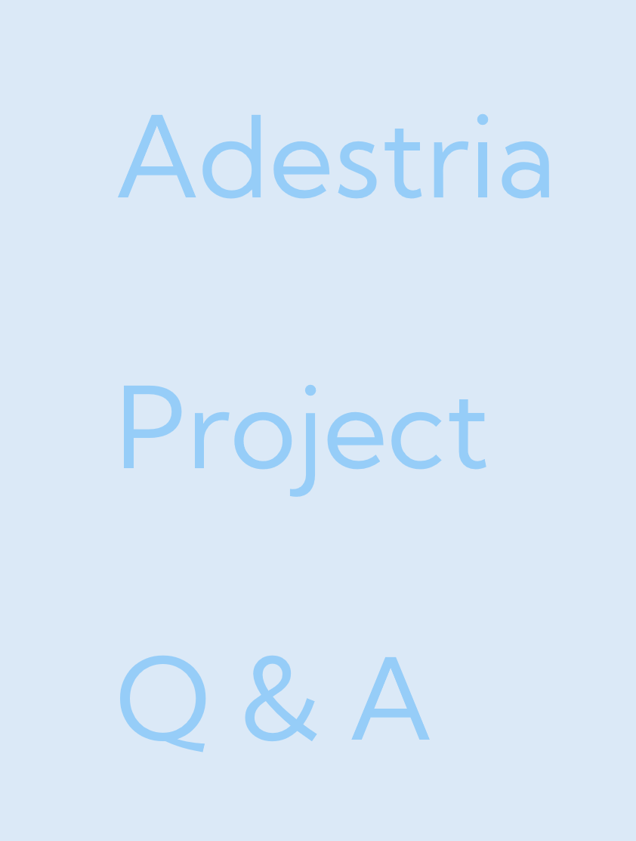
Adestria
Project
Q & A
Adestria
Project
Q & A

Slide 3
Adestria
Project
Q & A
Expand
•
Enhance
•
Create
Develop
Implement
Streamline
solutions to issues
Notes:
Mission: At Adestria, we create, develop, and implement dependable software solutions that address practical issues. We empower companies to confidently expand operations, enhance customer experience, and streamline their online presence through responsive front end design, clean architecture, and efficient back end systems.
Vision: To be a trustworthy technology partner with a reputation for creative software development, accessible digital design, and technical accuracy. By transforming complex requirements into accessible, and valuable user experiences, we hope to impact the direction of online and application systems in the future.

Slide 4
Adestria
Kayla
Jack
Edin
Jake
Steve
Project
Adestria
Project
Q & A
Web Dev, Integrated Systems Dev
Design Compliance
Excellent Standards & Accessibility
Notes:
Web Dev, Integrated Systems Dev Design Compliance Standards & Accessibility

Slide 5
Adestria
Kayla
Jack
Edin
Jake
Steve
Project
Web Dev, Integrated Systems Dev
Backend Dev
Excellent Professional Database
Past experience
Role
Expectations
Notes:
Past Experience: Worked previously with Gacko Designs with a few of Adestria's current team members in developing a website for an automotive repair business. Created an application that logged, managed, and filter employees personnel information.
Role: Backend
Expectations: Designing and the implementing data models and ensuring the system behind it adheres soundly to the client's business logic

Slide 6
Adestria
Kayla
Jack
Edin
Jake
Steve
Project
Web Dev, Integrated Systems Dev
Communications Manager
Improve Teamwork Skills
Notes:
Past Experience: Created a website for a book store in St. Catherines with a database, online purchases, and activity tracking. Created games using lua, python, C#, and websites using html, css, and javascript for personal use.
Role: Communications
Expectations: I want everyone to get better at working in a team professionally.

Slide 7
Adestria
Kayla
Jack
Edin
Jake
Steve
Project
Experienced Web Dev
Lead Dev
Professionally Lead Team
Notes:
Past Experience: Gacko designs - Worked with clients to design and develop a modern automotive website 6 Years of Personal Projects - Such as, Gambling Site, Type speed calculator
Role: Lead Developer
Expectations: Through this project I expect to lead a team throughout the development process and learn how to be a better leader

Slide 8
Adestria
Kayla
Jack
Edin
Jake
Steve
Project
Project
Q & A
Brock, Web Dev, Firmware Dev
Admin
Let Go, Let Grow
Notes:
Studied Comp Sci at Brock University, 3 years web dev experience, 1 year embedded firmware dev
Admin person, making ppt, compiling doc package, …
Learning to let other take the wheel and grow in their own domain

Slide 9
Adestria
Project
Q & A
Adestria
Project
Existing
Solutions
Custom
Solution
Comparison
Q & A
Works
Familiar
Pain Points
Notes:
Current situation/needs

Slide 10
Adestria
Project
Existing
Solutions
Custom
Solution
Comparison
Q & A
Management & Manufacturing
Documentation, Training, Risk Management
Extensive Logs
AI Integration
Hands Off
$25,000 /year
MasterControl

Slide 11
Adestria
Project
Existing
Solutions
Custom
Solution
Comparison
Q & A
Automated AI Training
Strong AI Integration
Aggressive Automations
Stiff AI Integration
Encrypted Data
$1,728 /year
Mitti

Slide 12
Adestria
Project
Existing
Solutions
Custom
Solution
Comparison
Q & A
Highly Optimized
Optional AI
Free Training
Your Data, Your Choice
Unlimited Storage, Auto-Compress
$500 /year
NCR Manager
Notes:
Starting at 500 per year

Slide 13
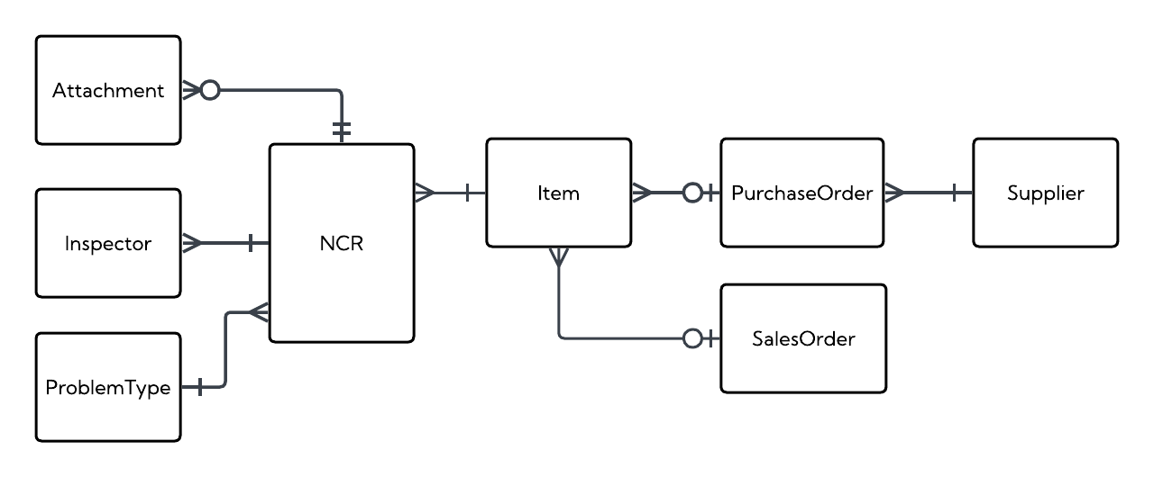
Adestria
Project
Existing
Solutions
Custom
Solution
Comparison
Q & A
NCR Manager

Slide 14
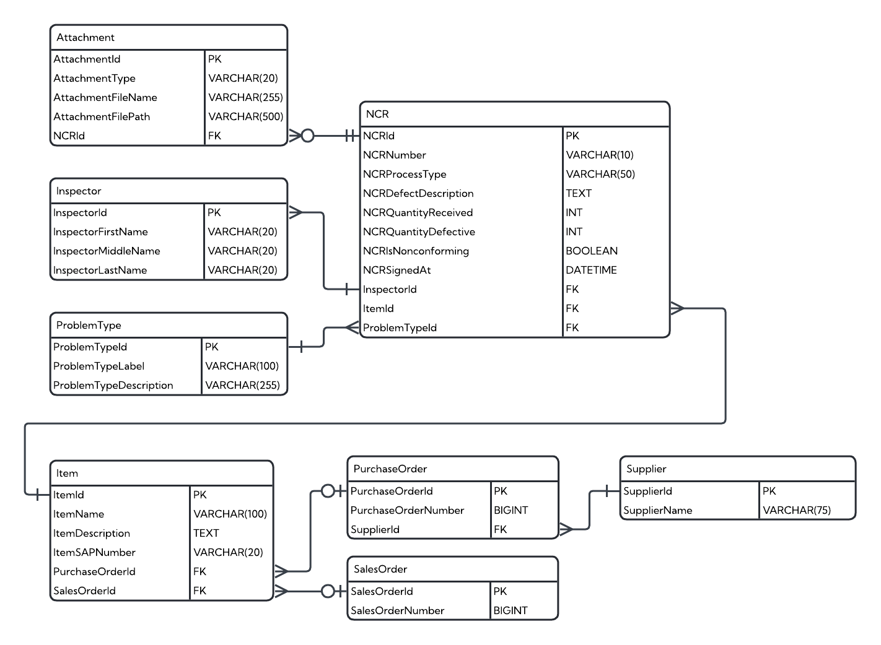
Adestria
Project
Existing
Solutions
Custom
Solution
Comparison
Q & A
NCR Manager

Slide 15
Adestria
Project
Existing
Solutions
Custom
Solution
Comparison
Q & A
Q & A
 | MasterControl | Mitti | NCR Manager
Setup Time | 1 – 3 Months | 8 Weeks | 4 - 5 Weeks
Training Time | 1 Month | 1 Month | 1 Month
Optional AI | No | No | Yes
Your Data | No | No | Yes
Price | $25,000 | $1,728 | $500

Slide 16
Adestria
Project
Q & A

